Slide 1
Capstone 2 Project
By Michael Hajjar

Slide 2
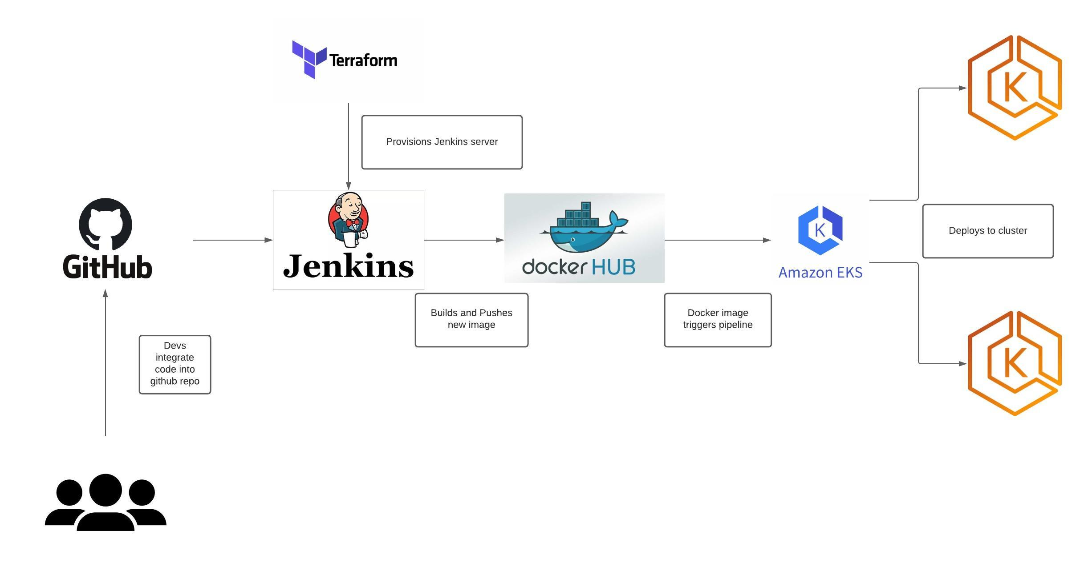

Slide 3
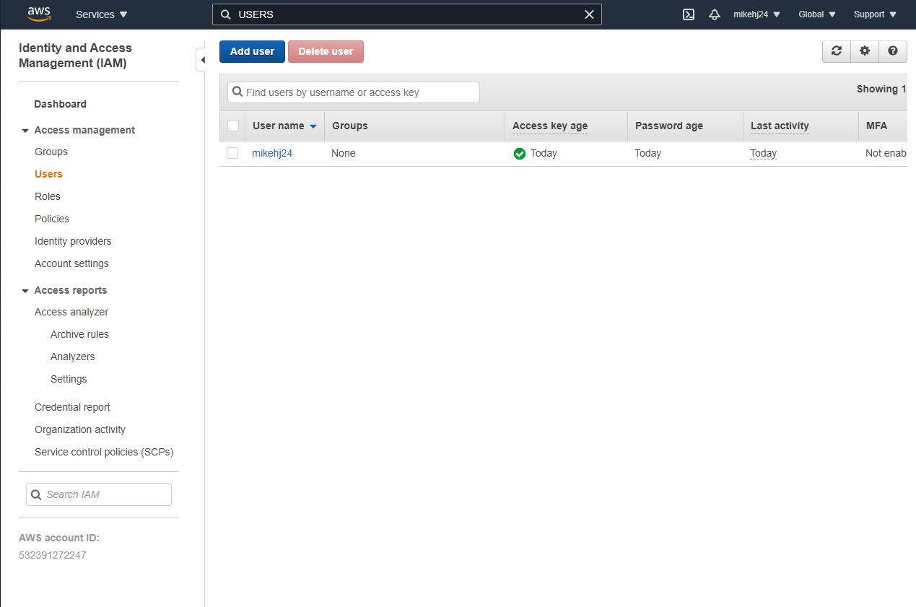
Elastic Kubernetes Service(EKS) on AWS

Slide 4
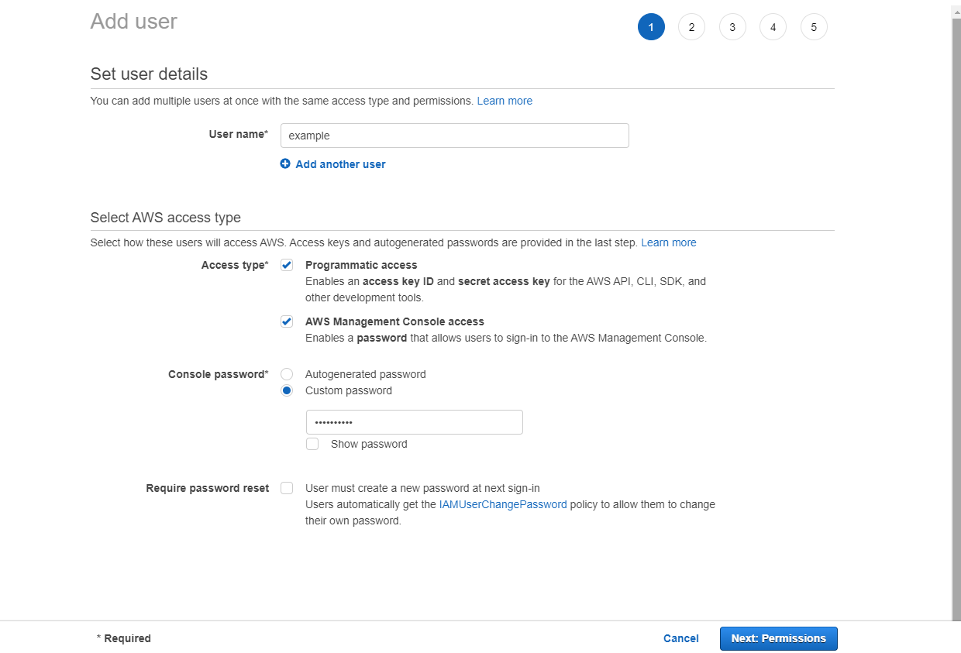

Slide 5
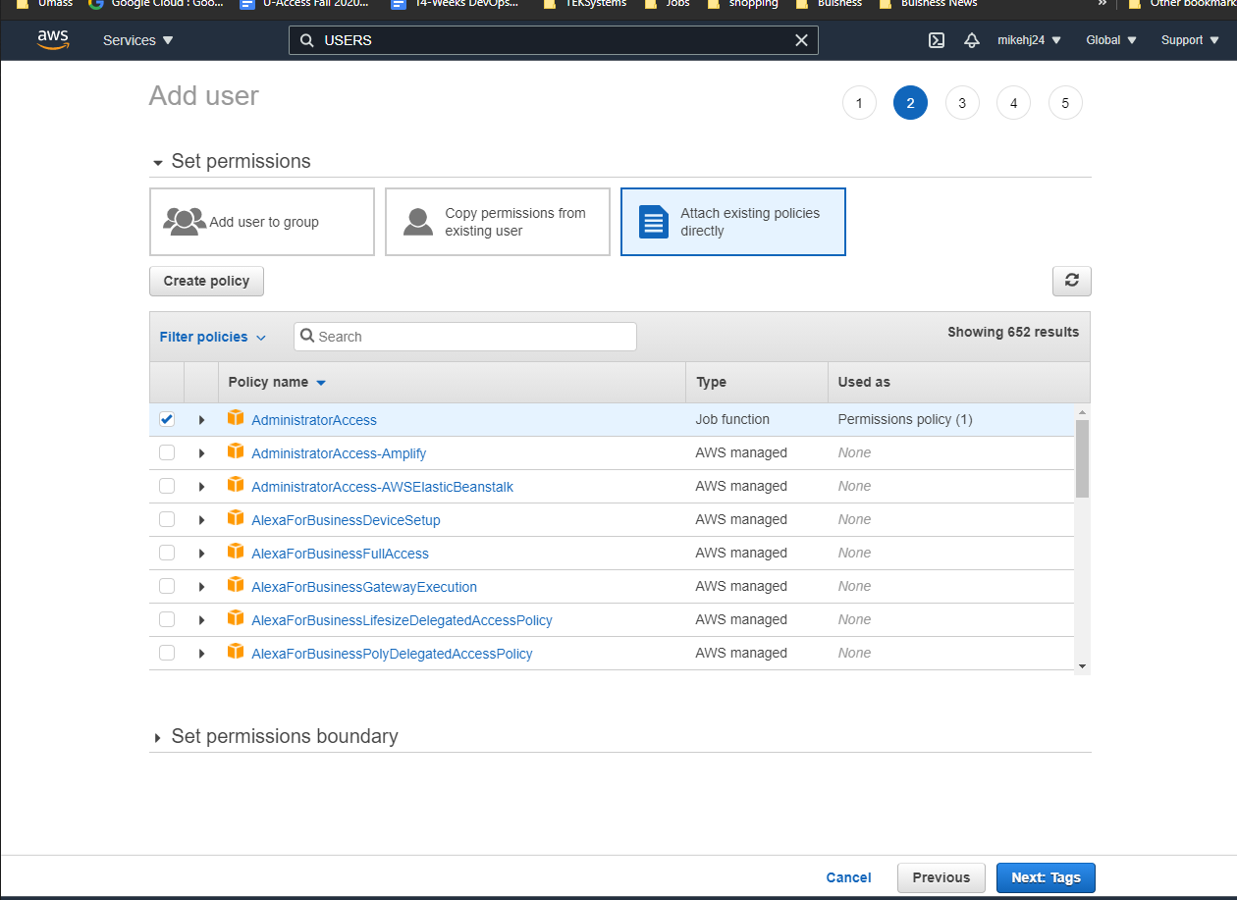

Slide 6
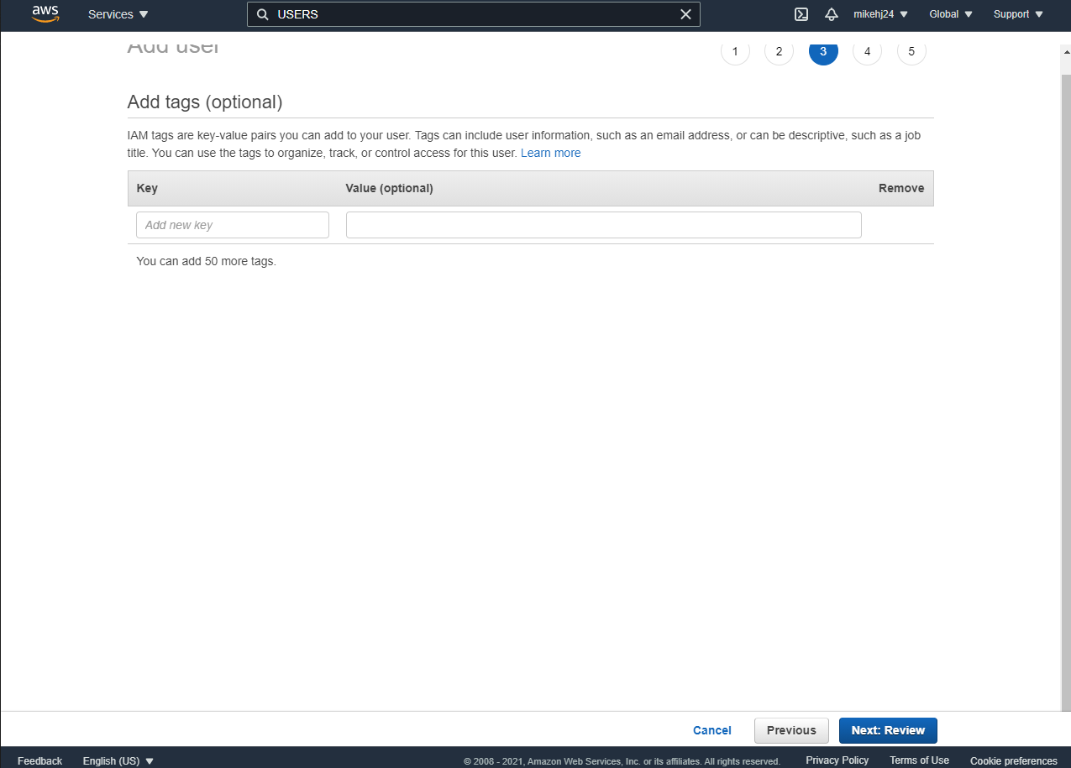

Slide 7
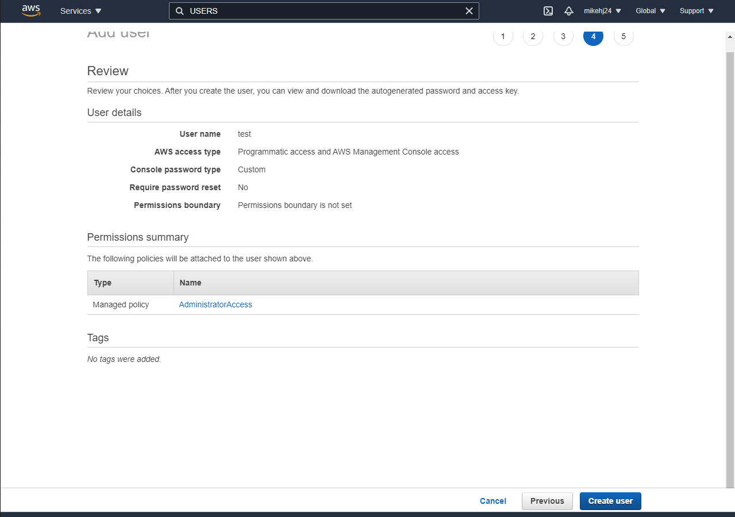

Slide 8
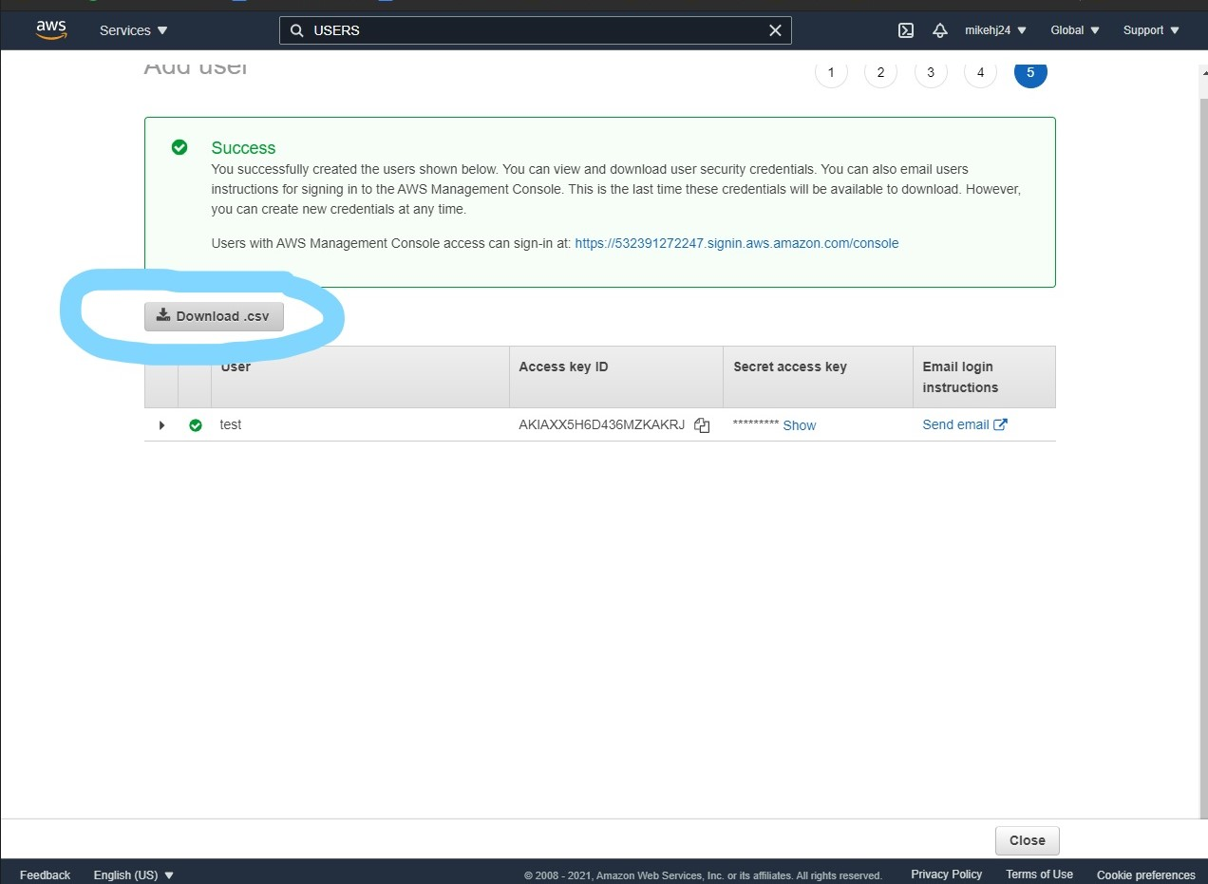

Slide 9
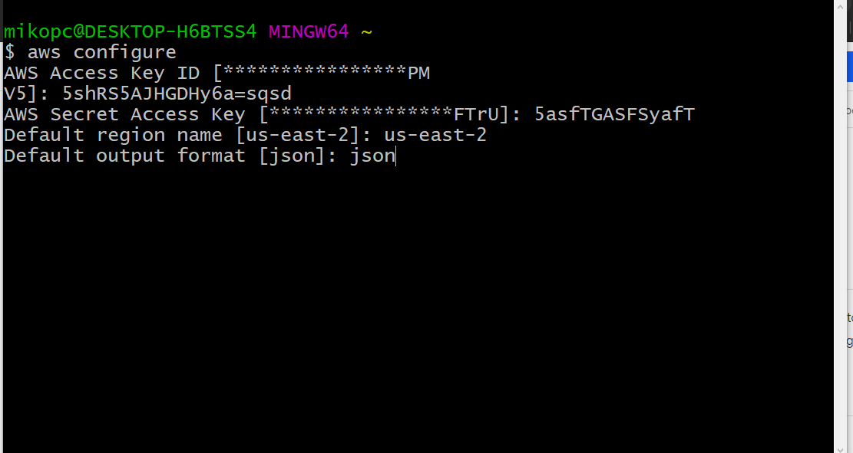

Slide 10
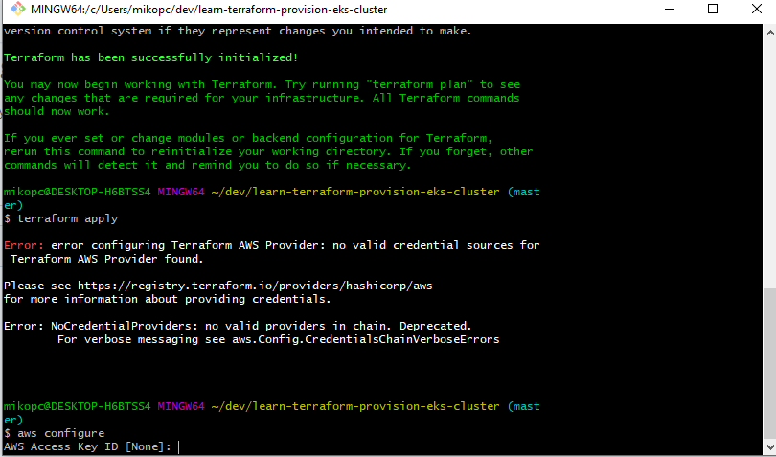

Slide 11
Tools You'll need
Configured AWS CLI
AWS IAM Authenticator
kubectl
Wget
https://learn.hashicorp.com/tutorials/terraform/eks?in=terraform/kubernetes&utm_source=WEBSITE&utm_medium=WEB_BLOG&utm_offer=ARTICLE_PAGE

Slide 12
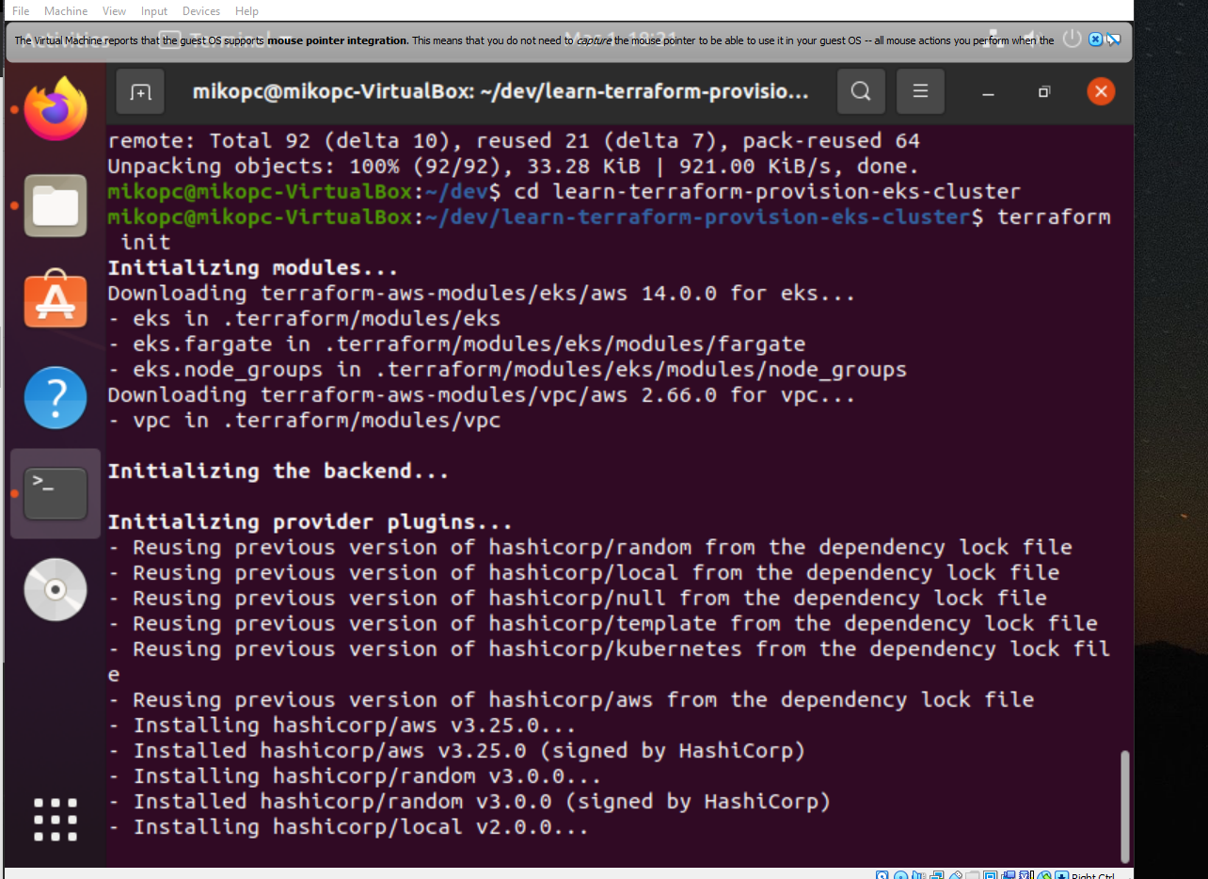

Slide 13
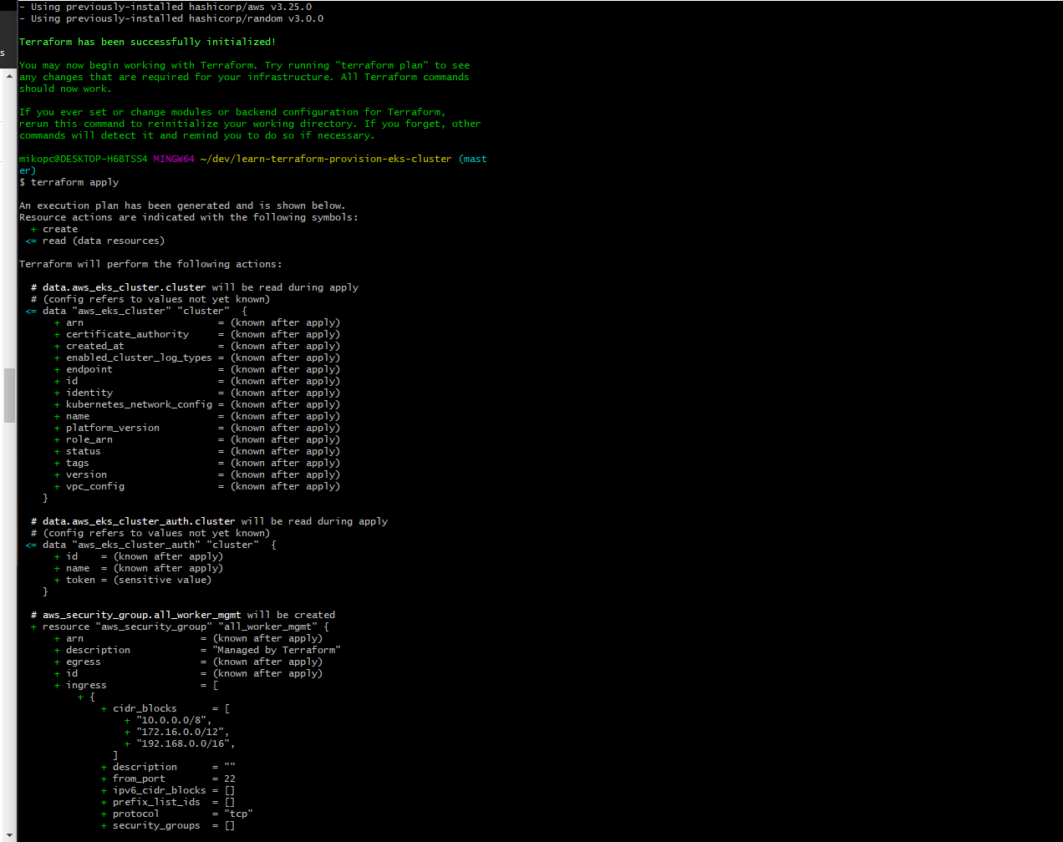
Terraform Apply

Slide 14
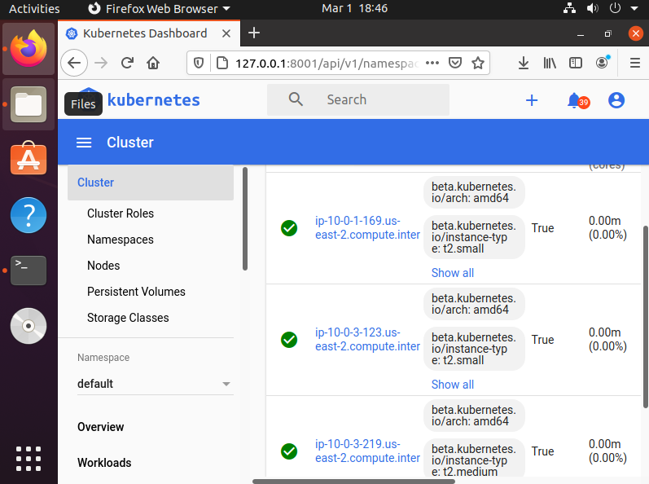

Slide 15
Jenkins

Slide 16
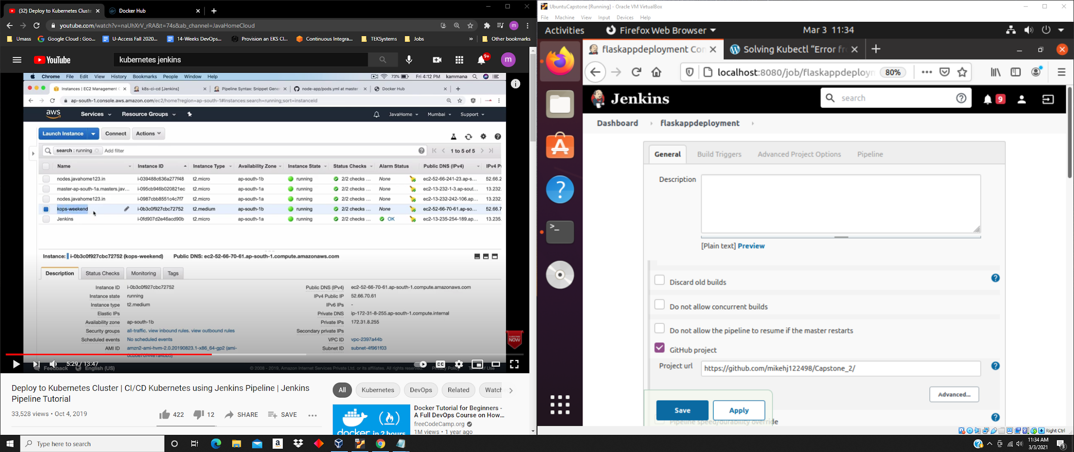

Slide 17
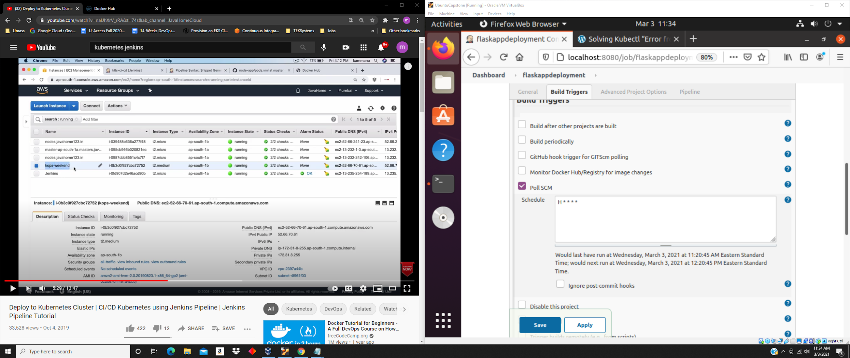

Slide 18
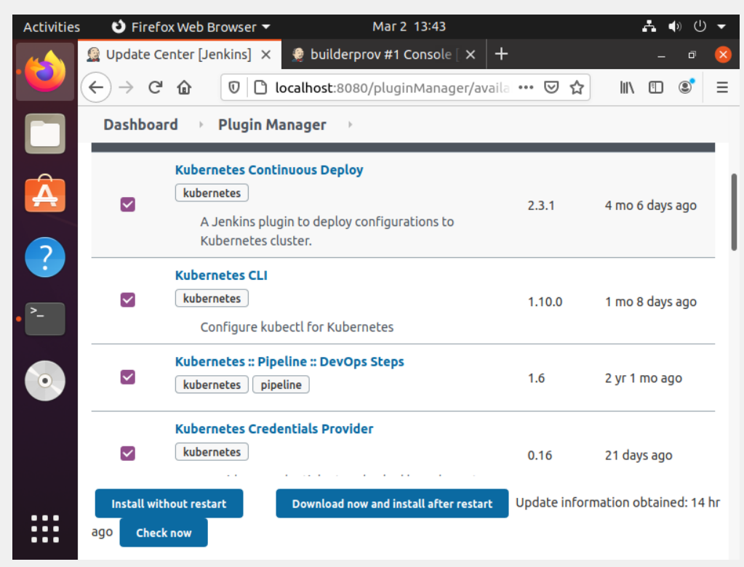

Slide 19
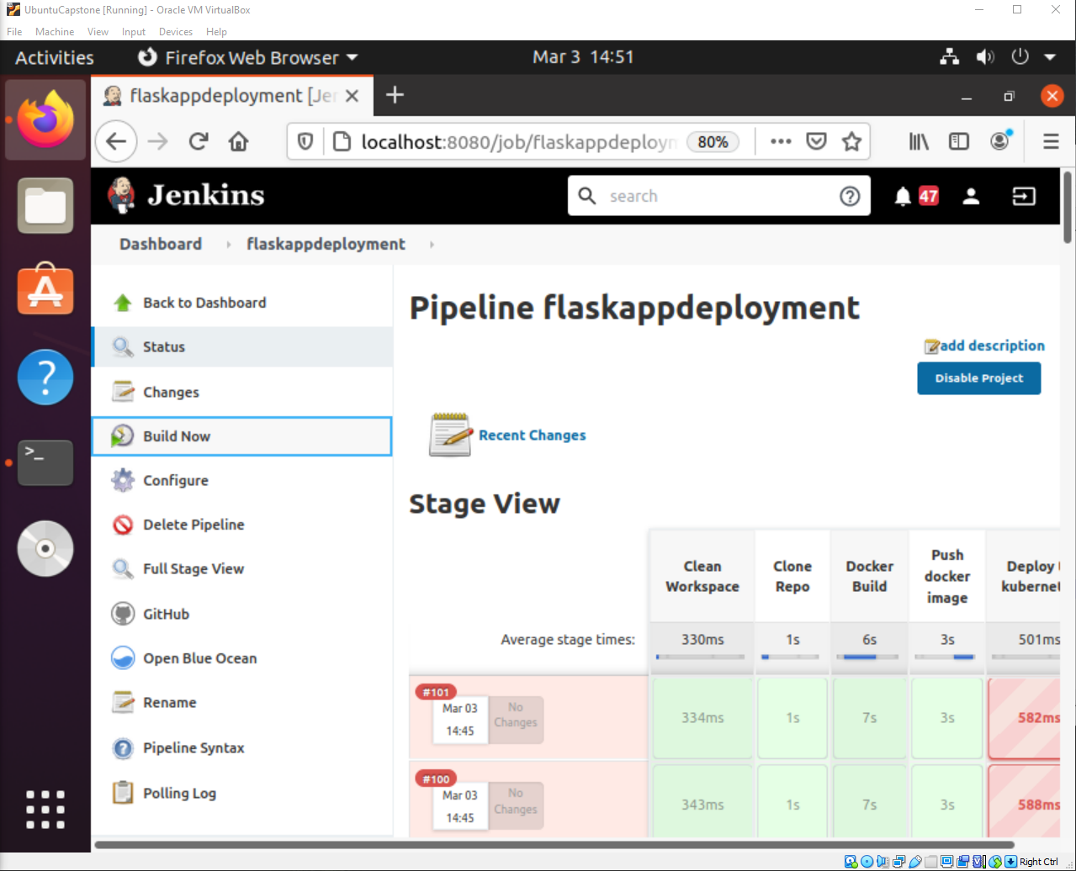

Slide 20
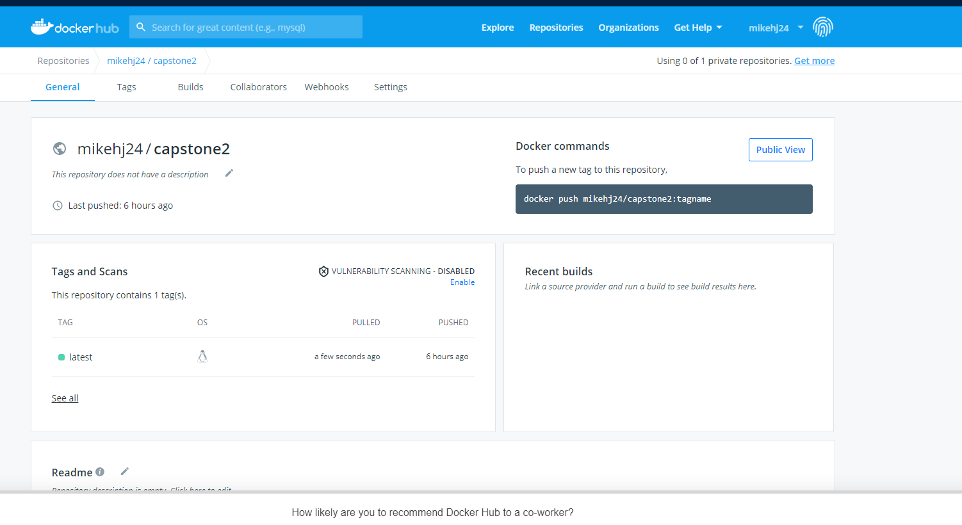

Slide 21
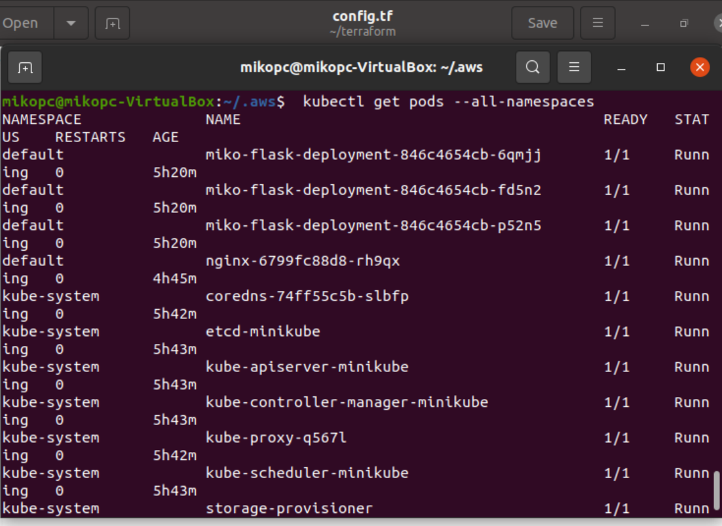

Slide 22
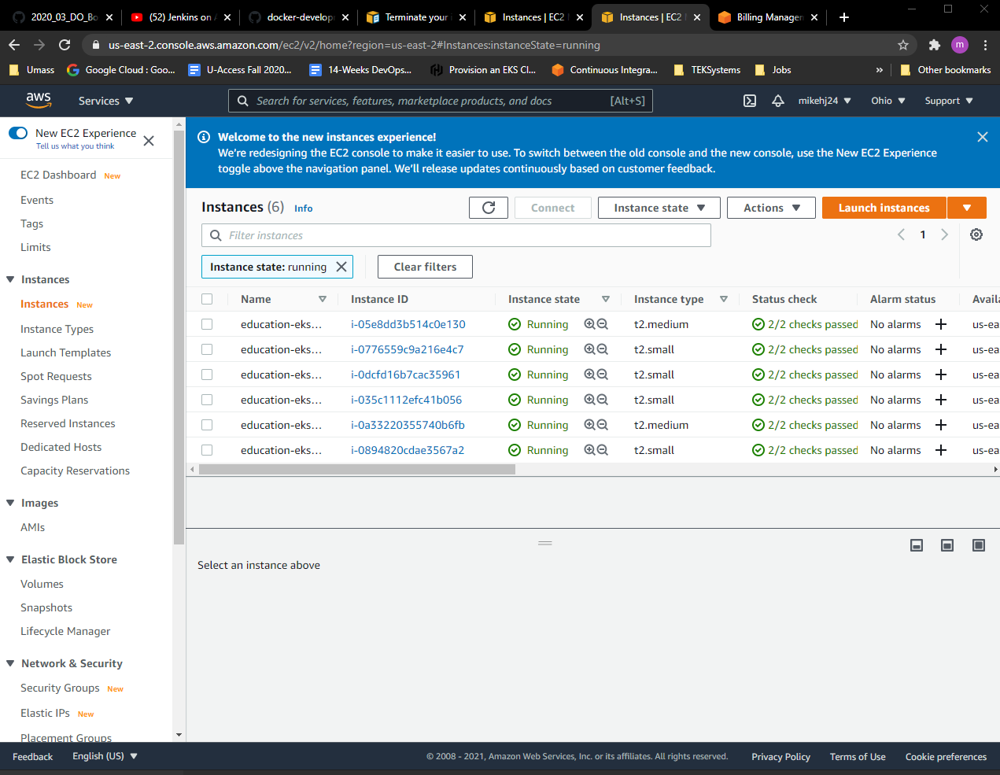

Slide 23
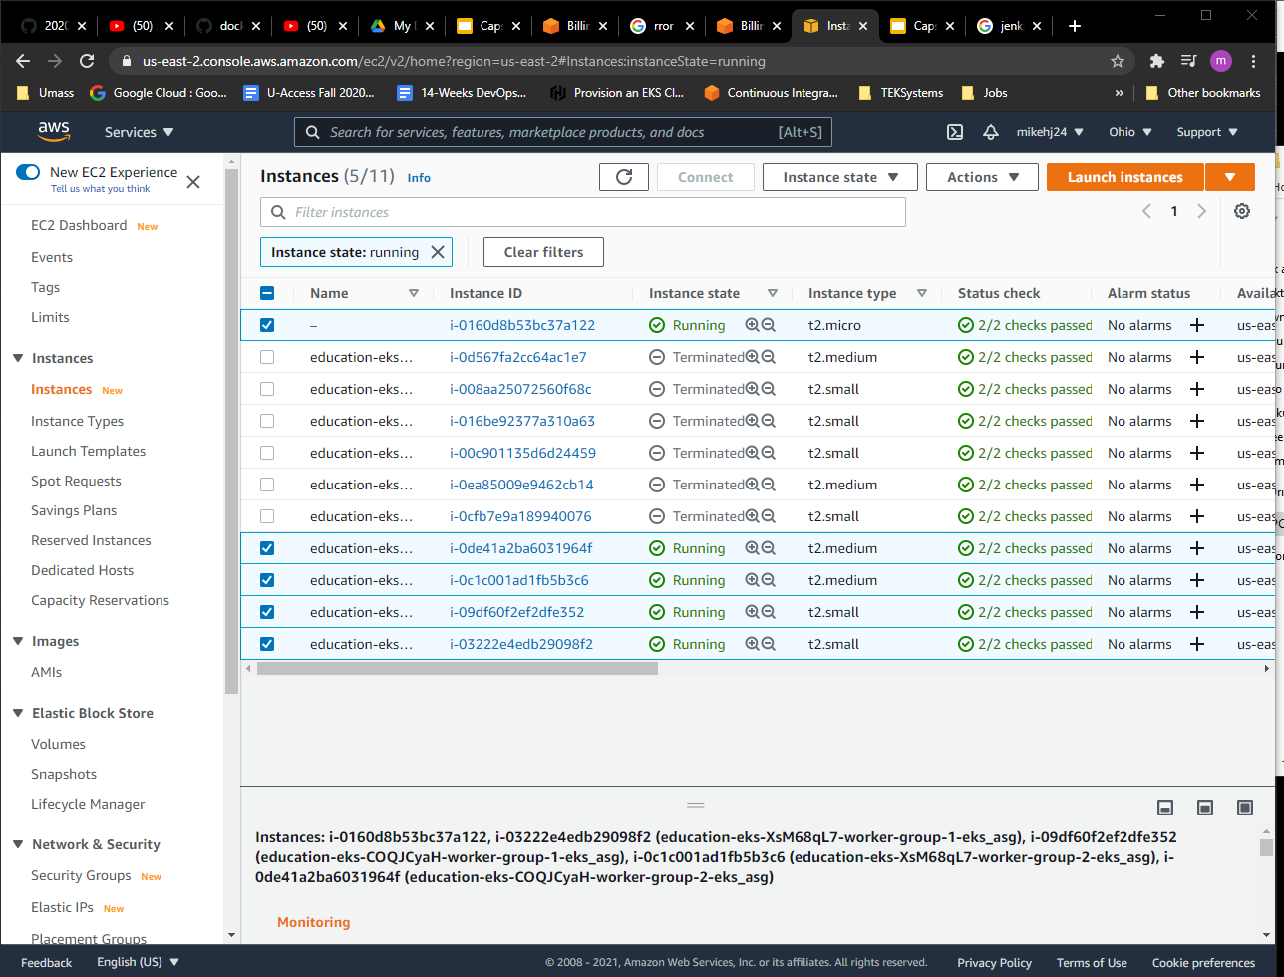

Slide 24
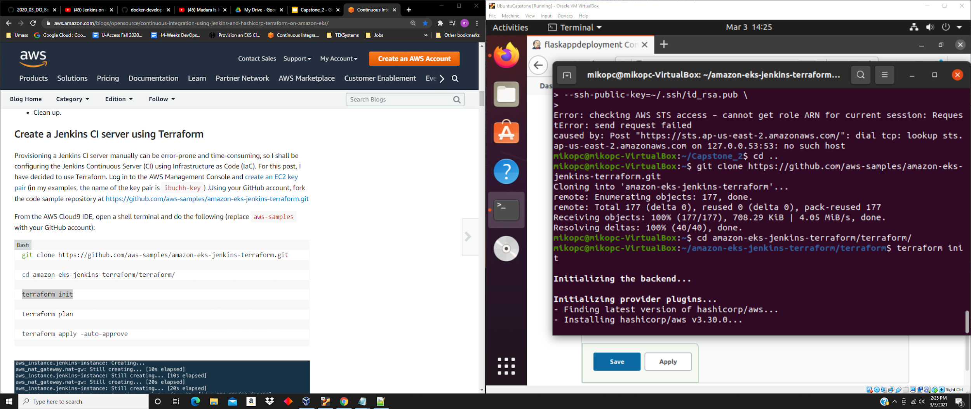

Slide 25
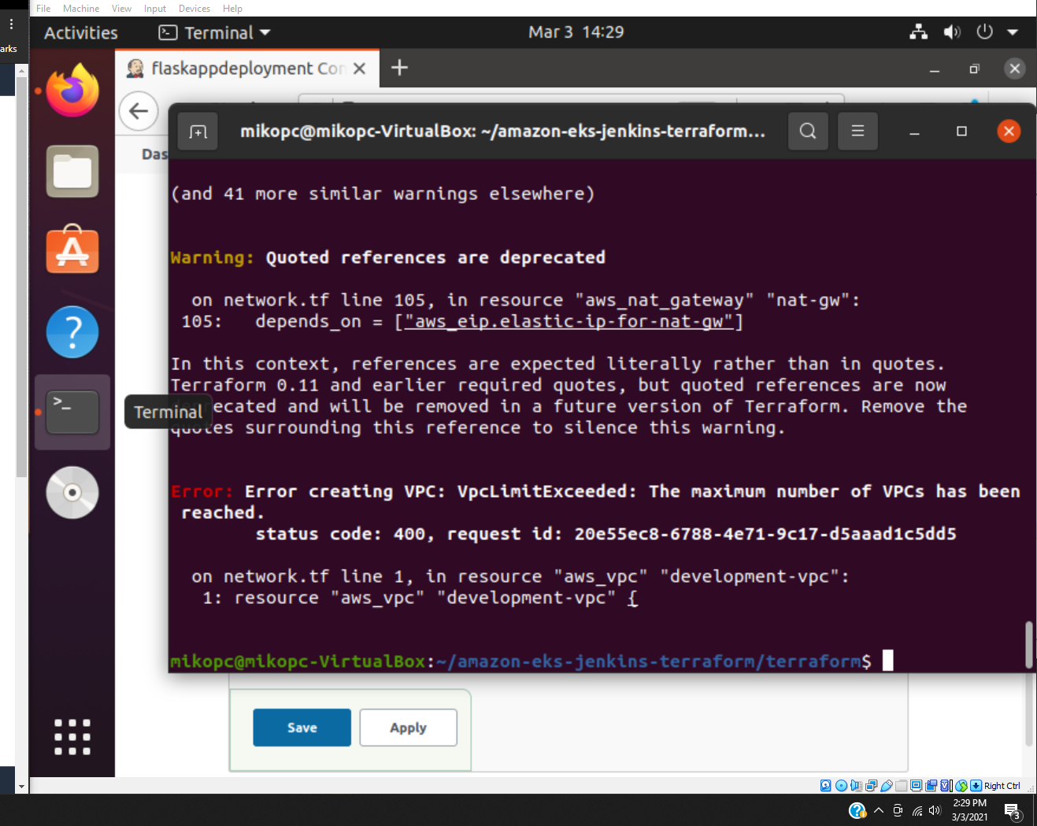

Slide 26
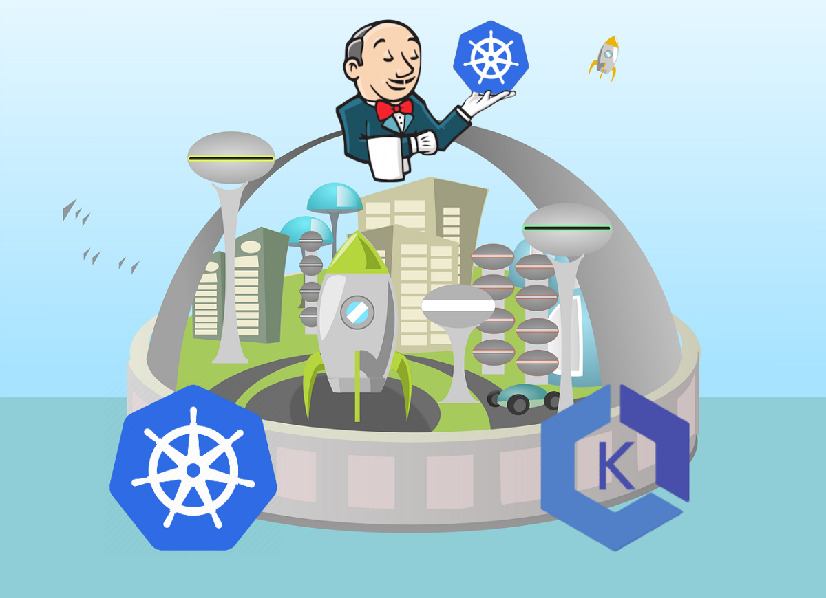

Slide 27
Regrets
Should have completed the project locally rather than on aws

Slide 28
Trying to run Terraform on Local Machine
Realized Windows 10 is not in a linux type environment as compared to MacOS and Linux, so switched over to do this in Ubuntu 20.04 Virtual Machine, worked perfectly

Slide 29
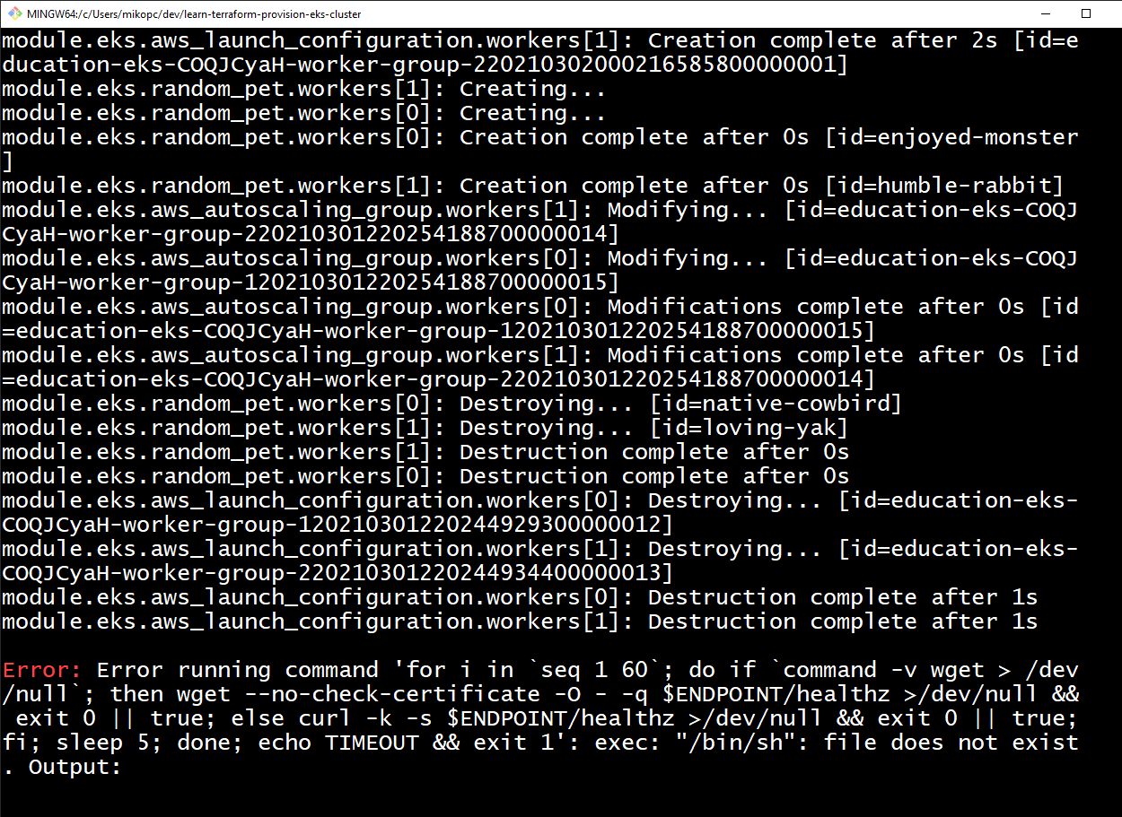

Slide 30
Virtual Machine stuck on boot
Took me a long time to try and figure out why image won't boot
Tried uninstalling & reinstalling virtualbox and downloaded other versions of Ubuntu such as 18.04
Ended up factory resetting computer to fix this
Problem was WSL2(Windows Subsystem for Linux) from docker desktop was causing this problem, had to reset again and not install docker desktop on local machine this time.

Slide 31


